Slide 1
Random Forest

Slide 2
TABLE OF CONTENTS
1.
4.
2.
5.
3.
6.
WHAT IS CLASSIFICATION
RANDOM FOREST VS DECISION TREE
Classificaton and its algorithms
Overfitting
Why “Random”
WHAT IS RANDOM FOREST
CODE
General definition
Bagging
Using Iris dataset to apply random forest algorithm
HOW DOES RANDOM FOREST WORK
The steps of implementing this algorithm
OUR TEAM

Slide 3
1
WHAT IS CLASSIFICATION

Slide 4
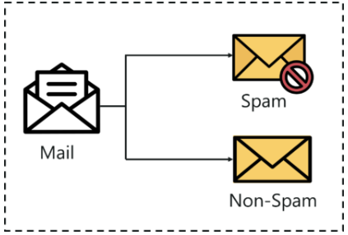
Classification
Classification is the method of predicting the class of a given input data point. Classification problems are common in machine learning, and they fall under the Supervised learning method.
Under classification we have 2 types:
Binary Classification
Multi-Class Classification
Binary classification

Slide 5
Classification Algorithms
Support Vector Machine
Logistic regression
Naive Bayes
K Nearest Neighbor (KNN)
Random Forest
Decision Tree

Slide 6
2
What is Random Forest

Slide 7
Random Forest
Random forest algorithm is a supervised classification and regression algorithm.
It’s built from a collection of Decision Trees, trained with the bagging method.
The higher the number of trees, the greater is the accuracy of the results.

Slide 8
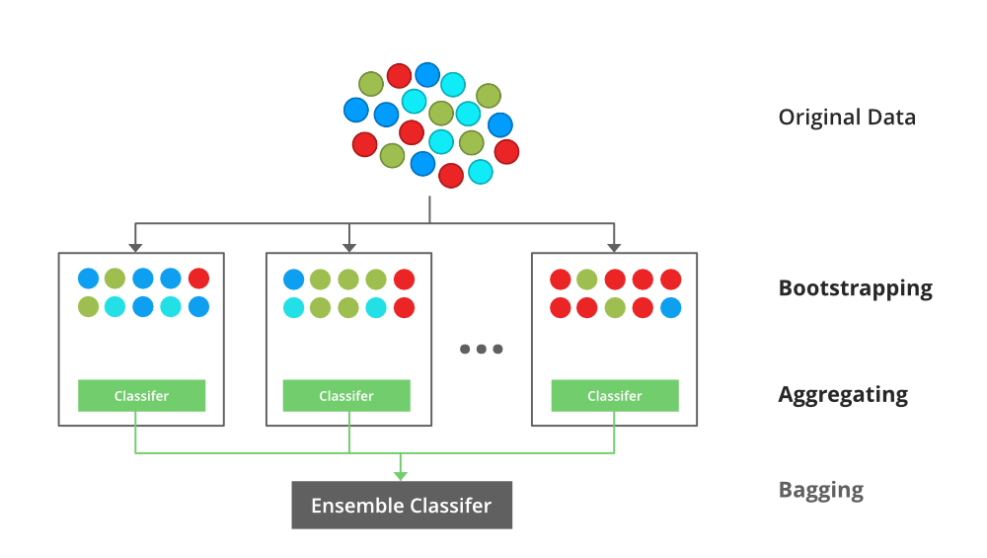
BAGGING
It is used to reduce the variation in the predictions by combining the result of multiple Decision trees on different samples of the data set.

Slide 9
BAGGING
Step 1
Step 3
Bootstrapping:
It is used to create diverse samples. This resampling method generates different subsets of the training dataset by selecting data points at random and with replacement.
Aggregation:
Finally, an average or a majority of the predictions are taken to compute a more accurate estimate. For classification problems, the class with the highest majority of votes is accepted; this is known as hard voting or majority voting.
Step 2
Parallel Trianing:
These bootstrap samples are then trained independently and in parallel with each other.

Slide 10
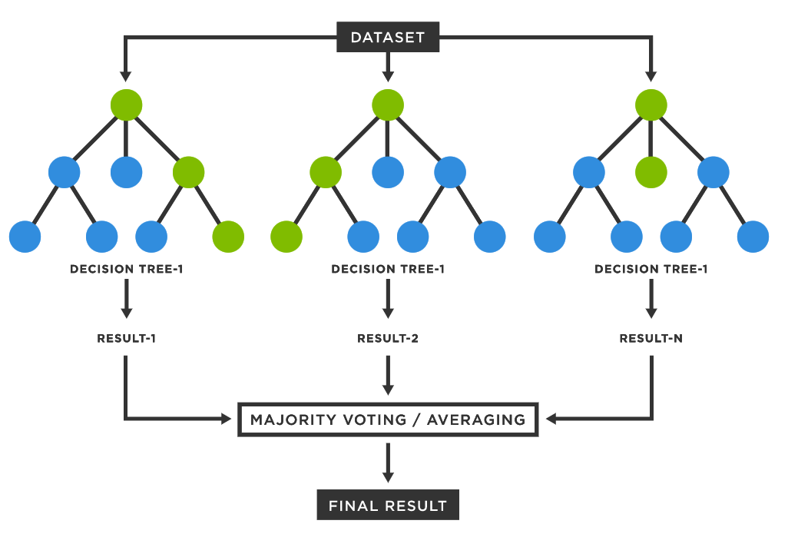

Slide 11
3
How does random forest work?

Slide 12
Creating a random forest
Step 1: Create a Bootstrapped Data Set
Step 2: Creating Decision Trees
Step 3: Go back to Step 1 and Repeat
Step 4: Predicting the outcome of a new data point
Step 5: Evaluate the Model

Slide 13
Step 1: create a bootstrapped data set
Bootstrapping is an estimation method used to make predictions on a data set by re-sampling it. To create a bootstrapped data set, we must randomly select samples from the original data set.
A point to note here is that we can select the same sample more than once.

Slide 14
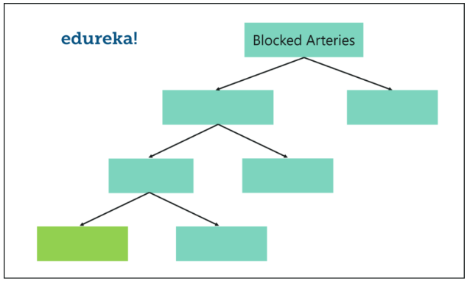
Step2: creating decision trees
Building a Decision Tree by using the bootstrapped data set created in the previous step.
Since we’re making a Random Forest, we will not consider the entire data set that we created, instead we’ll only use a random subset of features at each step.

Slide 15
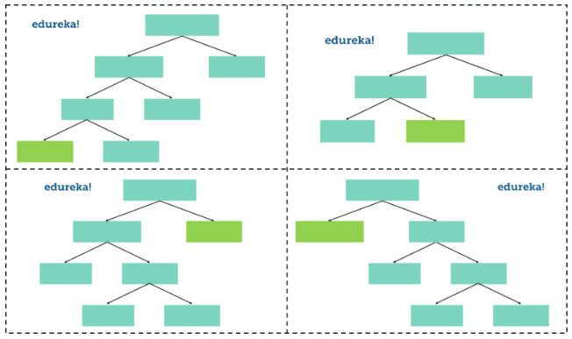
Step 3: Go back to Step 1 and Repeat
Creating more decision trees by considering a subset of random predictor variables (features) at each step.
To do this, go back to step 1, create a new bootstrapped data set and then build a Decision Tree by considering only a subset of features at each step.

Slide 16
Step 3: Go back to Step 1 and Repeat
This iteration is performed 100’s of times
Having such a variety of Decision Trees in a Random Forest is what makes it more effective than an individual Decision Tree created using all the features and the whole data set.

Slide 17
Step 4: Predicting the outcome of a new data point
We run this data down the other decision trees and keep a track of the class predicted by each tree. After running the data down all the trees in the Random Forest, we check which class got the majority votes.
(aggregation)

Slide 18
Step 5: Evaluate the Model
Eventually, we can measure the accuracy of a Random Forest by the proportion of Out-Of-Bag(OOB) samples that are correctly classified.

Slide 19
4
Random Forest VS Decision Tree

Slide 20
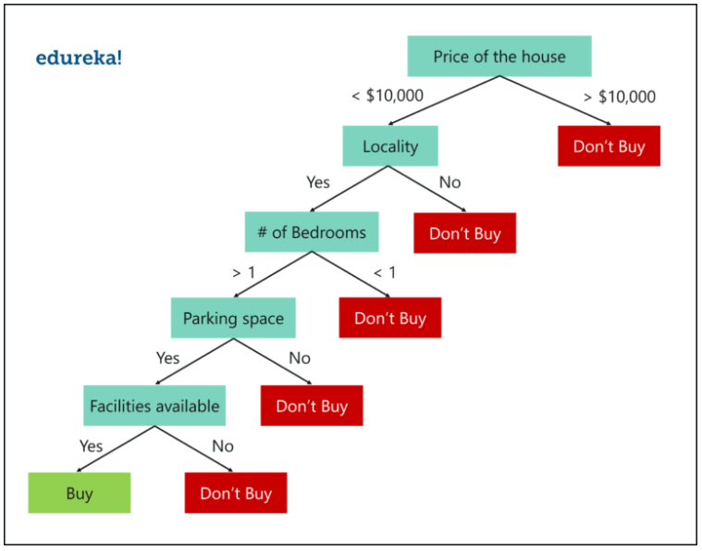
Decision Tree

Slide 21
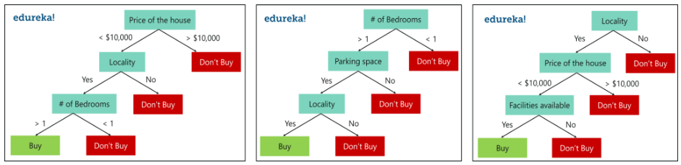
Random Forest

Slide 22
Random Forest VS Decision Tree
Decision Tree | Random Forest
A decision tree is a tree-like model of decisions along with possible outcomes in a diagram. | A classification algorithm consisting of many decision trees combined to get a more accurate result as compared to a single tree.
There is always a scope for overfitting, caused due to the presence of variance. | Random forest algorithm avoids and prevents overfitting by using multiple trees.
The results are not accurate. | This gives accurate and precise results.
Decision trees require low computation, thus reducing time to implement and carrying low accuracy. | This consumes more computation. The process of generation and analyzing is time-consuming.
It is easy to visualize. The only task is to fit the decision tree model. | This has complex visualization as it determines the pattern behind the data.

Slide 23
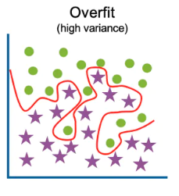
OVERFITTING
It occurs when a statistical model fits exactly against its training data.
It negatively influences the performance of the model on new data.

Slide 24
WHY “Random”
Bootstrap ensures that we don’t use the same data for every tree.
Random feature selection helps to reduce the correlation between the trees.

Slide 25
5
CODE

Slide 26
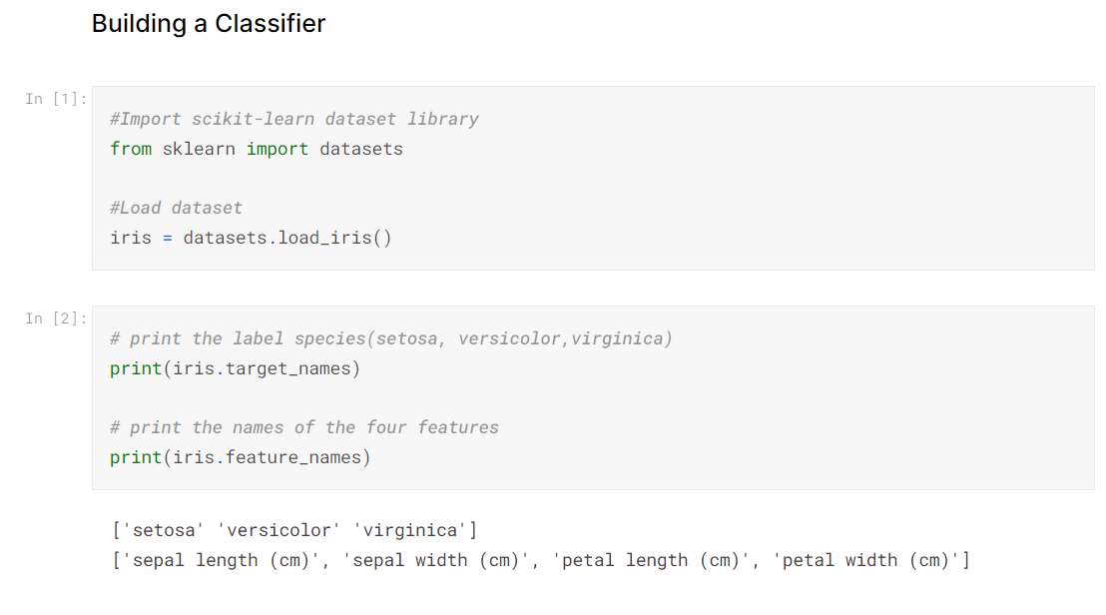

Slide 27
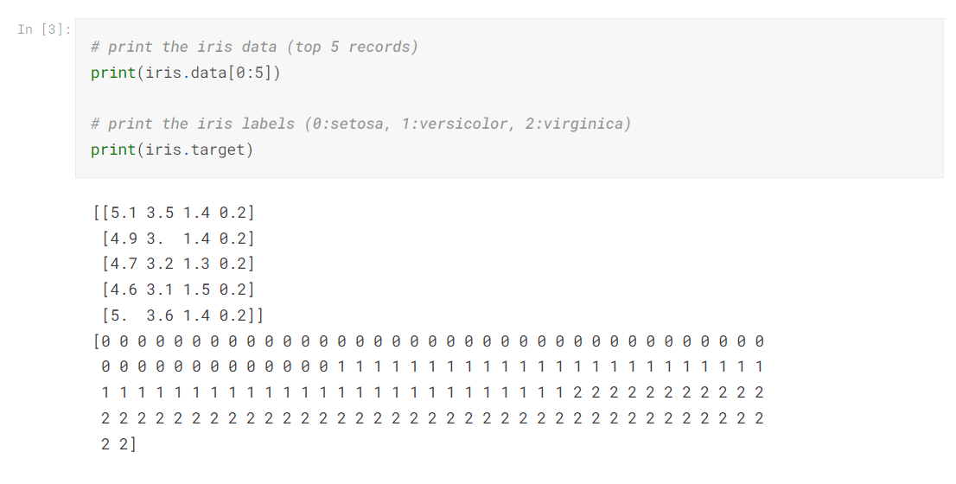

Slide 28
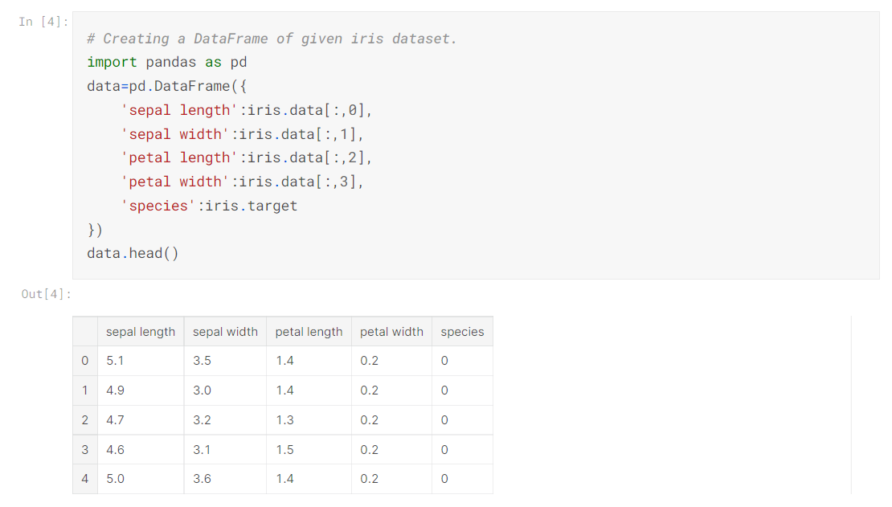

Slide 29
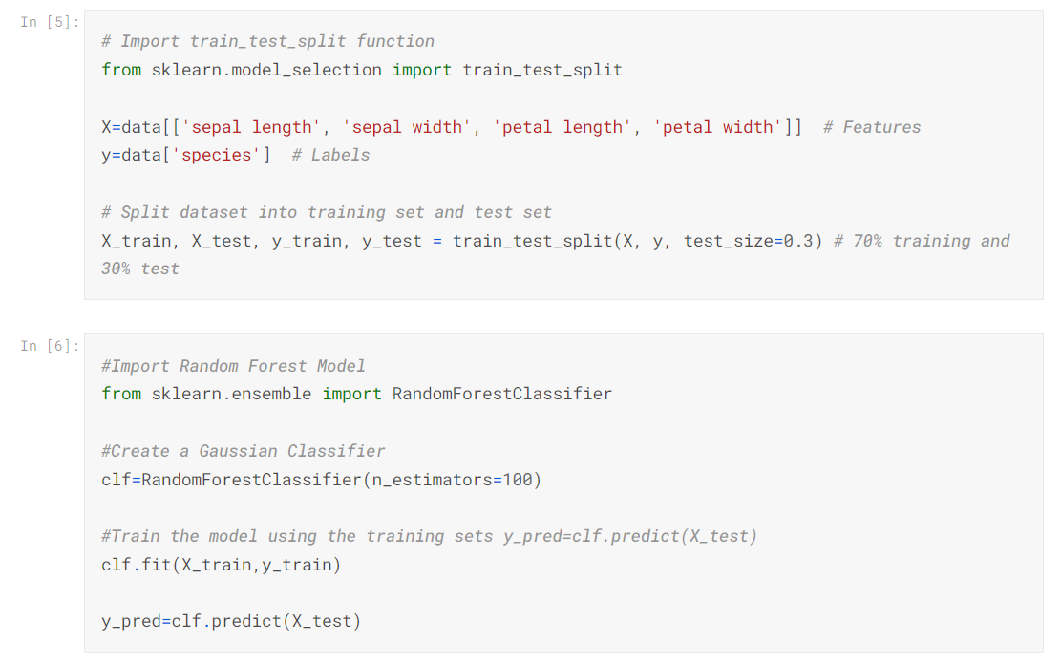

Slide 30
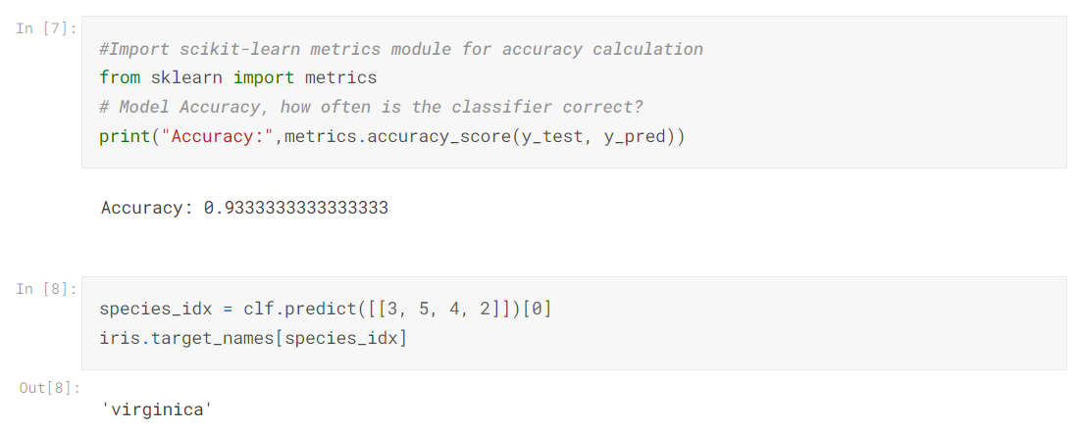

Slide 31
Improve our model

Slide 32
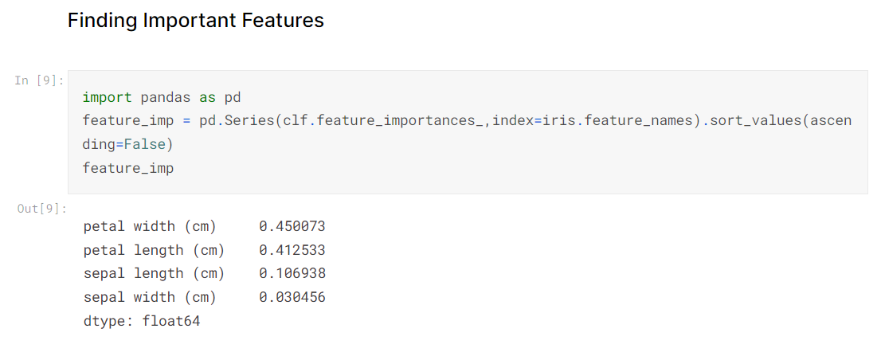

Slide 33
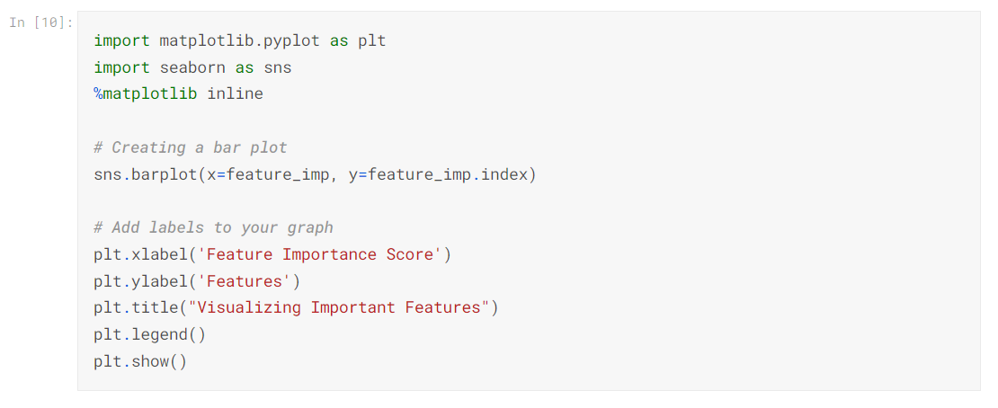
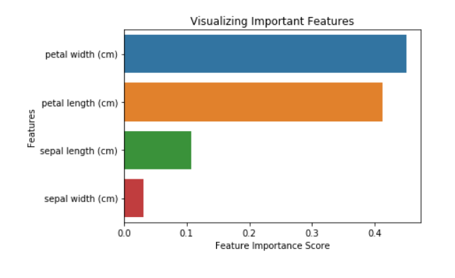

Slide 34
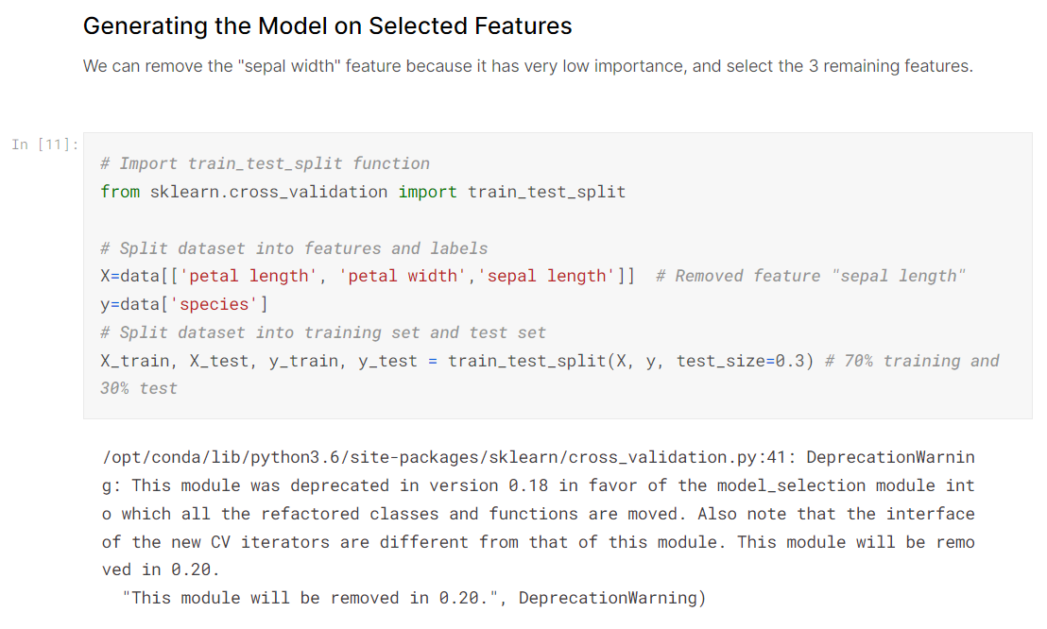

Slide 35
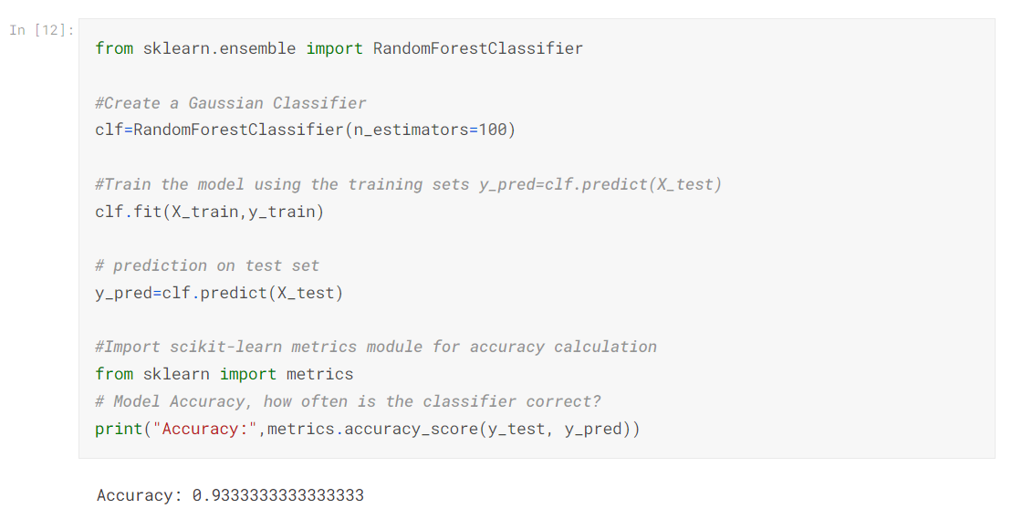

Slide 36
OUR TEAM
Zainab Sabry
Almoataz El-Naggar
Sara Glal
Nada Yasser
Baraa Ali
Yasmina Nosier

Slide 37
THANKS!
DO YOU HAVE ANY QUESTION?

